Slide 1
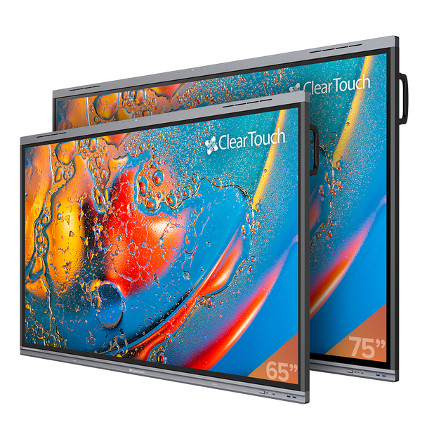
Troubleshooting & Guides

Slide 2
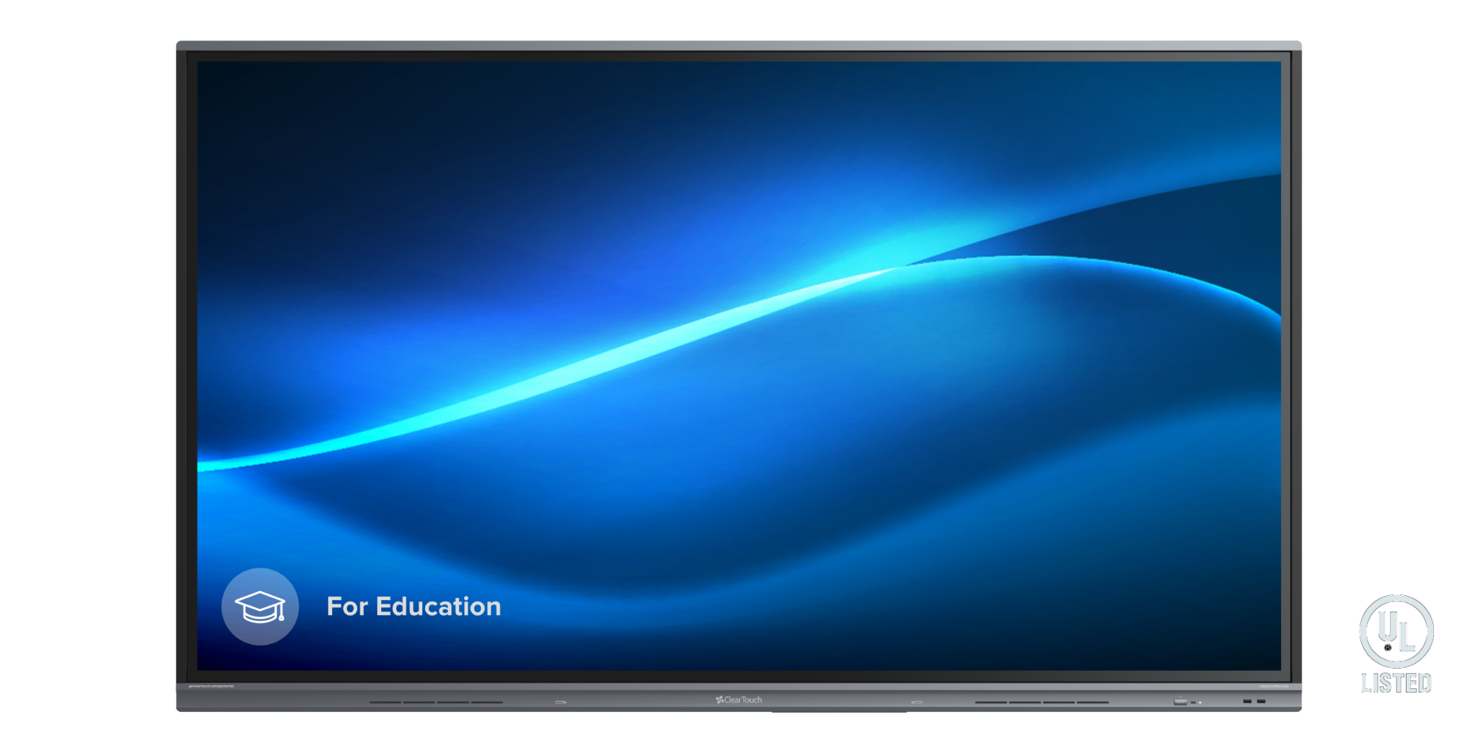
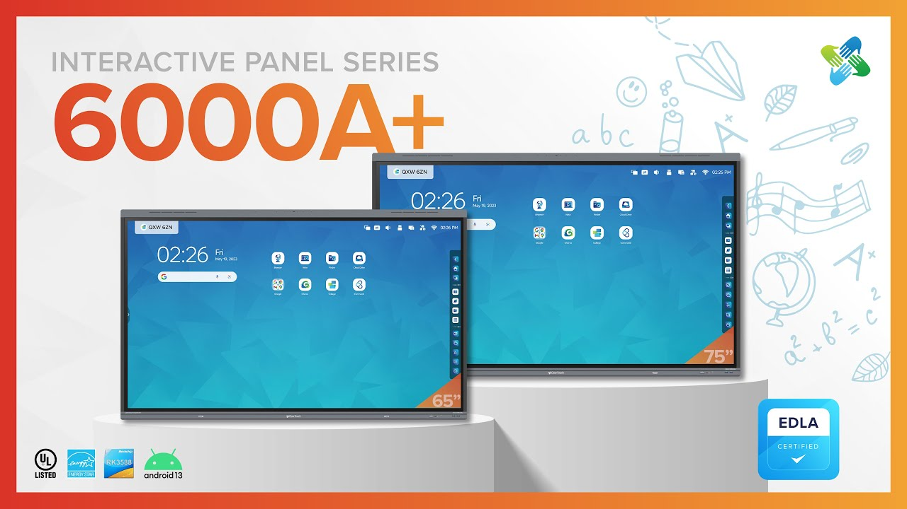
Panel Overview
K+ Models
NIO Models
(Non-Touch Cleartouch)
A+ Models

Slide 3
Panel Ports
Side Panel
Side Panel
6086A+
6086K+
55 NIO (Non-touch)
HDMI Input: 2
HDMI Output: 1
USB 2.0: 2
USB 3.0: 1
USB-C: 1
Reminder you will need a wireless keyboard/mouse to troubleshoot
HDMI Input 3
HDMI Output 1
USB 2.0 1
USB 3.0 4 Front ×2, Rear ×2
USB Type-C Input 3
Top input camera only
USB Type-C Output 1
Touch 2.0 2
Displayport Input 1
Bottom Panel
HDMI Output (Configurable) 1
USB 2.0 1
USB 3.0 4
Touch Output 2
USB C
HDMI Input 3
Bottom Panel
Bottom Panel
Bottom Panel

Slide 4
Quick Troubleshooting Guide
If possible bring with you:
Laptop
HDMI cable
USB A to B or USB C cable
Power
Turn off Micro PC
Power Cycle Cleartouch Panel (rocker switch)
Restart Micro PC
Did that fix it? If so, great and you are done!
Make sure system firmware is updated
FIRMWARE: Android settings->system->system update
Did that fix it? If so, great and you are done!
Check all cables going into panel - HDMI and USB
Did that fix it? If so, great and you are done!
Determine what Category Issue you are experiencing - see following slides
Factory Reset - kind of like a power wash
Still not working… Submit a support ticket to your TST ASAP!

Slide 5
IDENTIFYING & ISOLATING THE ISSUE
5 KEY CATEGORIES
Touch
Audio & Video
Power
Network
External Devices (PC, Cameras, etc)
Even if you can’t resolve the issue, information gathered while troubleshooting is key!

Slide 6
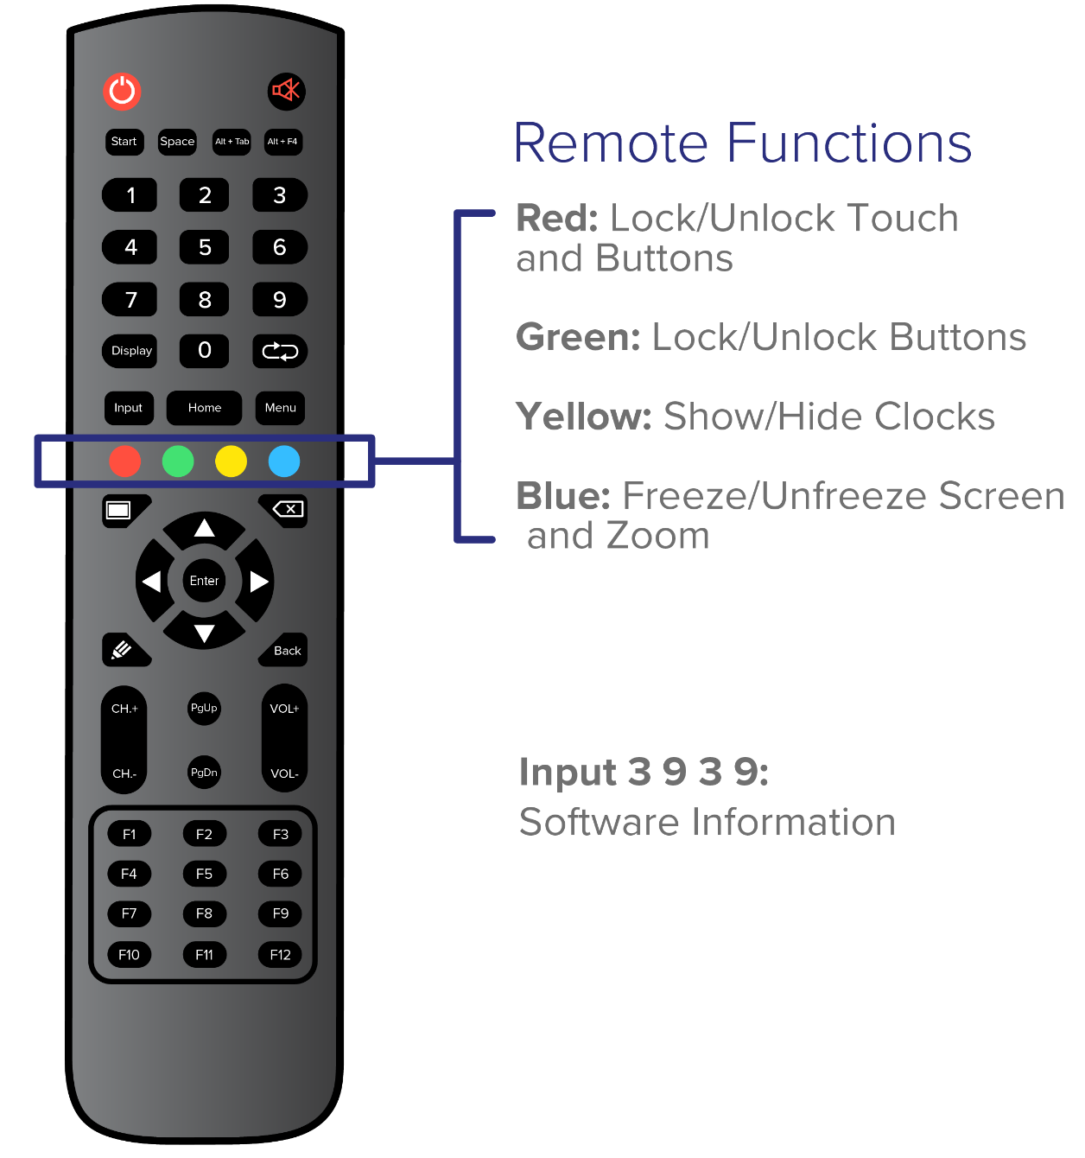
NO TOUCH!
What now…???
Touch Issue for Micro PC ONLY
Check cables; look for loose connections
Check Cleartouch remote (Red button if pressed can turn off touch to the panel)
Check USB port on PC (2.0 or 3.0)
Use 3.0 ports if possible (Blue)
USB drivers on Micro PC - Are they up to date?
Have you tested with your own laptop?
Touch Issue for BOTH Micro PC and Android
Power Cycle the panel
Rocker switch OR Unplug power cable
Factory Reset
How do you do that?

Slide 7
Audio & Video
NO AUDIO AT ALL
Check cables
Check PC - may be muted
Check Panel audio - volume may be way down
Youtube, Spotify and other apps - check volume
AUDIO FROM PC BUT NOT PANEL
Check output device in sound settings of PC
Look for “PC Monitor”

Slide 8
Audio & Video
NO VIDEO SIGNAL
Check panel input and check if micro PC is powered
Check HDMI cable from micro PC to panel
Are you on the correct panel input?
Is the Android side showing video?
HAVE A VIDEO SIGNAL, BUT IT’S NOT GOOD (DISTORTION OR STATIC)
Check cables and ports
Swap HDMI cable if you have it
Switch HDMI ports on back of micro PC
If this fixes the issue it is a micro PC issue, contact your TST and submit support ticket with the district for the PC.

Slide 9
Current Known Video Problem
Known CT Issues:
“HDMI NO SIGNAL” or “Detecting”
CT Development Team is working on a fix for future firmware.
Current Solution until firmware fix
Switch to Android then back to Hdmi 1 (if that's the source the PC is on)
Power Cycle Panel
Power Cycle PC
Unplug and Replug Hdmi cable

Slide 10
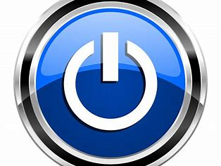
Power Issues?
NO POWER? What to do?
Check rocker switch and power cable on the panel
Confirm the electrical outlet is working
Try power cycle!
Try changing inputs to make sure not signal issue
Is the button powered or not? Does the power button change color when you press it? Red to white LED
If truly no power, likely hotswap, send ticket to NAVC and indicate you tested for power

Slide 11
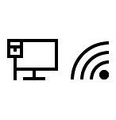
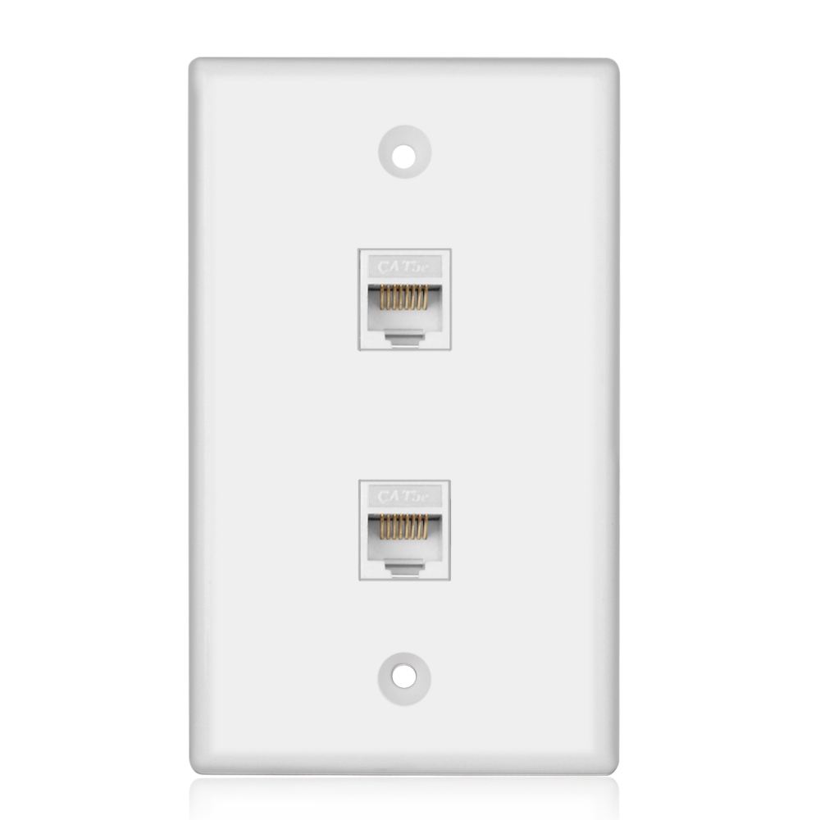
Network
Is the panel connected via hardwire or Wifi?
Ethernet
Make sure the data drop is live, you can do this with your laptop.
Connect your laptop to the data drop in question
Look for the Ethernet symbol
Check quality of Cat6 cables(network cable) you can test this with your laptop as well
WIFI
Check panel settings
Check the wifi module on the panel (usually on the bottom of the panel, or plugged into a usb port on the back of non-touch panels)
Confirm login credentials (Domain, Identity, Password)

Slide 12
External Devices
Micro PC
Problems can relate to the previous topics discussed USB drivers, cables
Hovercam, Webcams not functioning?
First thing to check: Is the USB from Micro PC to panel connected?
Try to use proper cabling when plugging up cameras
Make sure device is powered and tested (you can do this on the camera app)
Mouse and Keyboard not functioning?
First thing to check: Is the USB from Micro PC to panel connected?
USB dongle plugged into Micro PC OR front of panel

Slide 13
“Power Wash” - Factory Reset
Factory Reset
Go to command and take note of panels name for re-enrollment
THIS PANEL WILL BE UNENROLLED FROM COMMAND IF RESET!
Press the “input” button the immediately press “1-3-7-9”
Very first “Init panel” option then press confirm
Allow 5-15 minutes for panel to reset
Add back to command, settings and update collage
See next slide

Slide 14
Update Settings after Factory Reset
Panel Settings
GOOGLE SETUP ON CLEARTOUCH PANEL
Panel will pull up google welcome screen (Hi there screen) press “start”
next screen press “dont copy”
Then “skip” Google sign in
Scroll down through setting preferences then press “skip” then “skip anyway”
Press “Skip” for pin setup then “Skip anyway”
SKIP THE PANEL PIN SETUP SECTION
Set volume of panel output to 100% in the main control panel
Change display setting to “BRIGHT”
Remote control for panel; Hit “Input 1379” to access panel menu
Go to Android Setting
Change No Signal Poweroff - Off
Go to Remote Control
Set Wake-On-LAN to ON
Create name of panel device
HCS to provide Nisewonger AV ID naming string (ex: FES - 100)
Command app
Collage-make sure it is updated version
Command application
Enter organization code (613673) and email address (els@hallco.org)
Enter device name of panel (FES - Room #)
Check settings of Collage app
Change device name inside application to match Command device name
Menu- switch mode- turn permission mode on
Disable Chomecast device support
Disable Airplay device support
Disable Miracast device support

Slide 15
Still haven’t solved the problem!?
Call or email support! Both Cleartouch and NAVC are always here to answer any questions.
Submit a ticket within Incident IQ
Please provide the following information
School Name & Room Number
Serial Number of the Panel
Model of the Panel
A brief description of the issue
Troubleshooting steps that have been performed

Slide 16
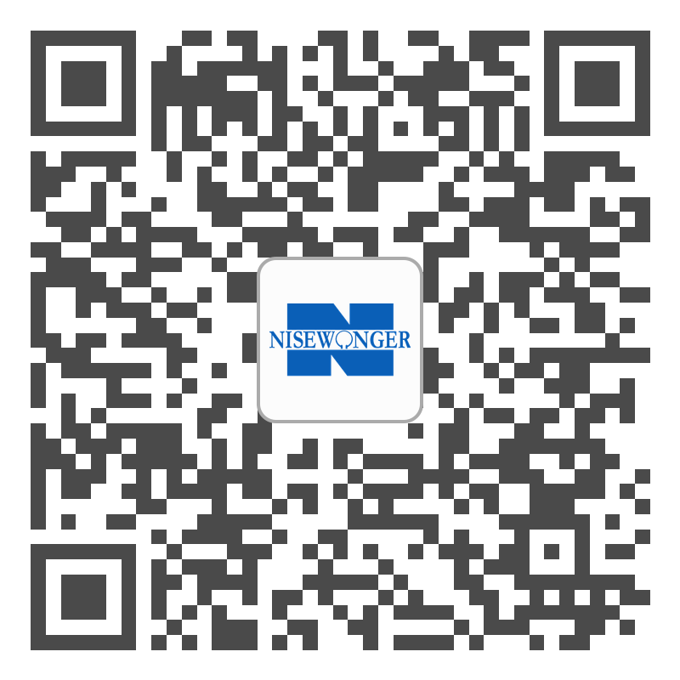
Q & A
Contact Information
Brandon Hemphill
Cell: 770-417-6561
Office: 770-338-0335
Support Email:
support@niseowongerav.com
Work Direct Email:
Brandon@nisewongerav.com
Cleartouch Tech Support
864-643-5045
it@getcleartouch.com

